Slide 1



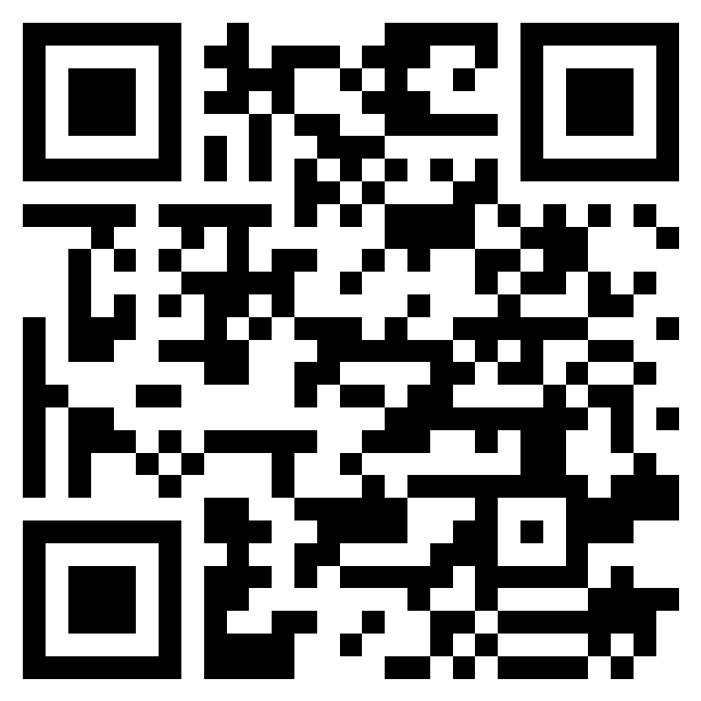















Jubail International School
JIS Mental Health Awareness Campaign
*Make Mental Health and Wellbeing for all a Global Priority*
Seminars for students and staff by
Doctor- A Psychiatrist
School Social Counsellor
Competitions by various departments
Keynote Speech by a Guest Speaker (1st November 2022)
Register for Keynote
From 23rd October – 3rd November 2022

Slide 2

Jubail International School
Opening Ceremony
AlHussan International Schools Elite Gavel Club
(Toastmasters International Gavel Club # 5077564 Division D, District 79 KSA)
Keynote Speech by Guest Speaker on
*Make Mental Health and Wellbeing for all a Global Priority*
Tuesday 1st November 2022 @ School Auditorium
5:00pm to 8:00pm
Seats are limited, please register if you would like to attend by scanning QR Code

Slide 3
Slide (1+1 banner)= total 2 Banners
Size: 232cm (wide) x 94cm (tall or long)

